Slide 1
ImagetoText

Slide 2
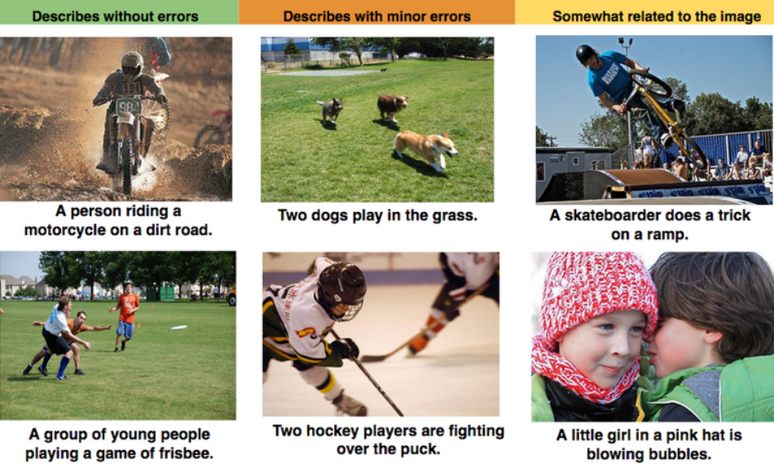
Practice 2
Title : Deep Visual-Semantic Alignments for Generating Image Descriptions
Image Captioning

Slide 3
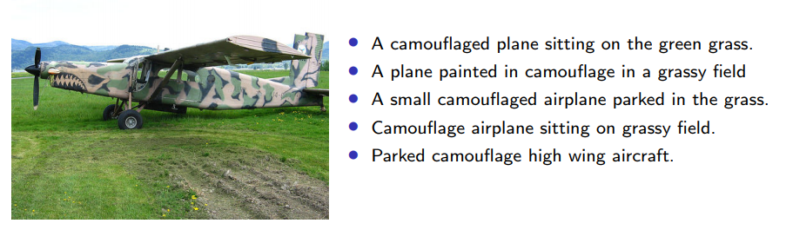
Practice 2: Image-to-Text
Dataset
Pascal sentence dataset (based on Pascal-2008)
Classification, Detection, Caption, etc
1000 images + 5 descriptions per image

Slide 4
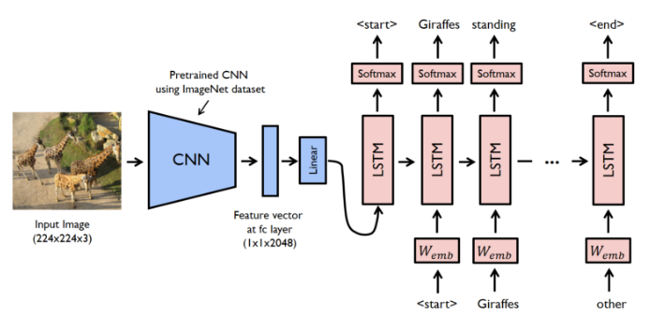
Practice 2: Image-to-Text
Model
Encoder
CNN
Decoder
LSTM

Slide 5
Practice 2: Image-to-Text
Read image data
Code
Read Text data
Code
def read_img(self, path): file_list = [] for (path, dir, files) in os.walk(path + "/dataset"): for filename in files: file_list.append("/".join([path, filename])) file_list.sort() return file_list
def read_text(self, path): file_list = [] for (path, dir, files) in os.walk(path + "/sentence"): for filename in files: file_list.append("/".join([path, filename])) file_list.sort() return file_list

Slide 6
Practice 2: Image-to-Text
Image to Array
Code
def img_files(self, file_list): images = [] for file_name in file_list: img = cv2.imread(file_name, cv2.IMREAD_COLOR) img_resized = cv2.resize(img, dsize=(self.img_x_size, self.img_y_size)) images.append((img_resized - 127.5) / 127.5) return np.array(images)

Slide 7
Practice 2: Image-to-Text
Text to Array
Code
def text_files(self, file_list): ids = [] lengths = [] for file_name in file_list: with open(file_name, "r") as fin: lines = fin.readlines() id = np.zeros((len(lines), self.max_len), dtype=np.int32) length = np.zeros(len(lines), dtype=np.int32) for i, line in enumerate(lines): line += "<eos>" for j, word in enumerate(line.split()): if j == self.max_len: break if word not in self.w2idx: self.w2idx[word] = len(self.w2idx) id[i][j] = self.w2idx[word] length[i] = j+1 ids.append(id) lengths.append(length) return np.array(ids), np.array(lengths)

Slide 8
Practice 2: Image-to-Text
Preprocessing
Code
self.path = path self.max_len = max_len self.max_vocab = max_vocab self.img_x_size = img_x_size self.img_y_size = img_y_size self.w2idx = {end_token: 0, "<unk>": 1} img_list, text_list= self.read_img(path), self.read_text(path) img_text = [(img_list[i], text_list[i]) for i in range(len(img_list))] random.shuffle(img_text) img_list, text_list = [], [] for img, text in img_text: img_list.append(img) text_list.append(text) self.imgs = self.img_files(img_list) self.ids, self.lengths = self.text_files(text_list) self.vocab_size = len(self.w2idx) print(" - vocab_size: {}".format(self.vocab_size))

Slide 9
Practice 2: Image-to-Text
Embedding Layer (Model)
Initialize Variable
class Model(object): def __init__(self, emb_dim=128, hidden_dim=128, vocab_size=40, max_len=50, img_x=128, img_y=128, use_clip=True, learning_rate=0.001): self.initializer = tf.random_uniform_initializer(-0.1, 0.1) self.emb_dim = emb_dim self.hidden_dim = hidden_dim self.vocab_size = vocab_size self.max_len = max_len self.use_clip = use_clip self.learning_rate = learning_rate

Slide 10
Practice 2: Image-to-Text
Setup Layers (Model)
Encoder
Use Convolutional Neural Network for Image
Decoder
Use LSTM for Text

Slide 11
Practice 2: Image-to-Text
Setup Layers (Model)
Encoder
Use Convolutional Neural Network for Image

Slide 12
Practice 2: Image-to-Text
Setup Layers (Model)
Code
def image_cnn(self): conv_f1 = tf.get_variable(name='conv_f1', shape=[3, 3, 3, 128], dtype=tf.float32, initializer=self.initializer) conv_b1 = tf.get_variable(name='conv_b1', shape=[128], dtype=tf.float32, initializer=self.initializer) conv_l1 = self.leaky_relu(tf.nn.conv2d(self.img, filter=conv_f1, strides=[1, 2, 2, 1], padding='SAME') + conv_b1) pool_l1 = tf.nn.max_pool(conv_l1, [1, 2, 2, 1], strides=[1, 2, 2, 1], padding="VALID") print(pool_l1 .shape) conv_f2 = tf.get_variable(name='conv_f2', shape=[3, 3, 128, 128], dtype=tf.float32, initializer=self.initializer) conv_b2 = tf.get_variable(name='conv_b2', shape=[128], dtype=tf.float32, initializer=self.initializer) conv_l2 = self.leaky_relu(tf.nn.conv2d(pool_l1, filter=conv_f2, strides=[1, 2, 2, 1], padding='SAME') + conv_b2) pool_l2 = tf.nn.max_pool(conv_l2, [1, 2, 2, 1], strides=[1, 2, 2, 1], padding="VALID") print(pool_l2.shape)

Slide 13
Practice 2: Image-to-Text
Setup Layers (Model)
Code
Encoder의 마지막 State를 Decoder의 init_state로 사용하
conv_f3 = tf.get_variable(name='conv_f3', shape=[3, 3, 128, 64], dtype=tf.float32, initializer=self.initializer) conv_b3 = tf.get_variable(name='conv_b3', shape=[64], dtype=tf.float32, initializer=self.initializer) conv_l3 = self.leaky_relu(tf.nn.conv2d(pool_l2, filter=conv_f3, strides=[1, 2, 2, 1], padding='SAME') + conv_b3) pool_l3 = tf.nn.max_pool(conv_l3, [1, 2, 2, 1], strides=[1, 2, 2, 1], padding="VALID") print(pool_l3.shape) conv_f4 = tf.get_variable(name='conv_f4', shape=[3, 3, 64, 64], dtype=tf.float32, initializer=self.initializer) conv_b4 = tf.get_variable(name='conv_b4', shape=[64], dtype=tf.float32, initializer=self.initializer) conv_l4 = self.leaky_relu(tf.nn.conv2d(pool_l3, filter=conv_f4, strides=[1, 1, 1, 1], padding='SAME') + conv_b4) pool_l4 = tf.nn.max_pool(conv_l4, [1, 2, 2, 1], strides=[1, 2, 2, 1], padding="VALID") print(pool_l4.shape) self.img_vector = tf.reshape(pool_l4, [-1, 2*2*64]) converter_c = Dense(self.hidden_dim, activation=tf.nn.tanh, dtype=tf.float32) converter_h = Dense(self.hidden_dim, activation=tf.nn.tanh, dtype=tf.float32) self.init_state = LSTMStateTuple(converter_c(self.img_vector), converter_h(self.img_vector)) print(self.init_state.h.shape)

Slide 14
Practice 2: Image-to-Text
Setup Layers (Model)
Code
def decoder_train(self): # time-batch-dimension text_emb_tbd = tf.transpose(self.text_emb, [1, 0, 2]) word_prob = tf.TensorArray(dtype=tf.float32, size=self.max_len) def body(step, state, word_prob): word_logit = self.out_layer(tf.concat([state.h, self.img_vector], 1)) word_prob = word_prob.write(step, word_logit) token_emb = text_emb_tbd[step] next_out, next_state = self.decoder_cell(token_emb, state) return step + 1, next_state, word_prob _step, _state, _word_prob = tf.while_loop( cond=lambda t, _state, _word_prob: t < self.max_len, body=body, loop_vars=(0, self.init_state, word_prob)) self.train_prob = tf.transpose(_word_prob.stack(), perm=[1, 0, 2])

Slide 15
Practice 2: Image-to-Text
Setup Layers (Model)
Decoder
Use LSTM for Text

Slide 16
Practice 2: Image-to-Text
Setup Layers (Model)
Code
def decoder_train(self): # time-batch-dimension text_emb_tbd = tf.transpose(self.text_emb, [1, 0, 2]) word_prob = tf.TensorArray(dtype=tf.float32, size=self.max_len) def body(step, state, word_prob): word_logit = self.out_layer(tf.concat([state.h, self.img_vector], 1)) word_prob = word_prob.write(step, word_logit) token_emb = text_emb_tbd[step] next_out, next_state = self.decoder_cell(token_emb, state) return step + 1, next_state, word_prob _step, _state, _word_prob = tf.while_loop( cond=lambda t, _state, _word_prob: t < self.max_len, body=body, loop_vars=(0, self.init_state, word_prob)) self.train_prob = tf.transpose(_word_prob.stack(), perm=[1, 0, 2])

Slide 17
Practice 2: Image-to-Text
Setup Layers (Model)
Code
def decoder_infer(self): word_token = tf.TensorArray(dtype=tf.int32, size=self.max_len) def body(step, state, word_token): word_logit = self.out_layer(tf.concat([state.h, self.img_vector], 1)) next_token = tf.cast(tf.reshape(tf.argmax(word_logit, 1), [-1]), tf.int32) word_token = word_token.write(step, next_token) token_emb = tf.nn.embedding_lookup(self.emb_W, next_token) next_out, next_state = self.decoder_cell(token_emb, state) return step + 1, next_state, word_token _step, _state, _word_token = tf.while_loop( cond=lambda t, _state, _word_token: t < self.max_len, body=body, loop_vars=(0, self.init_state, word_token)) self.output_token = tf.transpose(_word_token.stack(), perm=[1, 0])

Slide 18
Practice 2: Image-to-Text
Setup Layers (Model)
Code
self.image_cnn() self.decoder_cell = LSTMCell(self.hidden_dim, state_is_tuple=True) self.out_layer = Dense(self.vocab_size, name='out_layer') self.decoder_train() self.decoder_infer()

Slide 19
Practice 2: Image-to-Text
Build Loss
Code
Build Optimizer
Code
def build_loss(self): self.cross_entropy = tf.nn.sparse_softmax_cross_entropy_with_logits(labels=self.text, logits=self.train_prob) self.loss = tf.reduce_sum(self.cross_entropy * self.masks) / (tf.reduce_sum(self.masks) + 1e-10)
def build_opt(self): # define optimizer optimizer = tf.train.AdamOptimizer(learning_rate=self.learning_rate) grad, var = zip(*optimizer.compute_gradients(self.loss))

Slide 20
Practice 2: Image-to-Text
Train Model and Result
Code
for it in range(0, 10000): img, text, text_len = data.get_train(BATCH_SIZE) feed_text, feed_length = [], [] for i in range(len(text)): idx = random.randint(0, len(text[i])-1) feed_text.append(text[i][idx]) feed_length.append(text_len[i][idx]) feed_dict = {model.img: img} feed_dict[model.text] = feed_text feed_dict[model.text_len] = feed_length loss, _ = sess.run([model.loss, model.update], feed_dict=feed_dict) avg_loss += loss it_cnt += 1 if it % it_log == 0: print(" it: {:4d} | loss: {:.3f} - {:.2f}s".format(it, avg_loss / it_cnt, time.time() - start_time)) avg_loss, it_cnt = 0, 0 if it % it_test == 0 and it > 0: test_model() if it % it_save == 0 and it > 0: model.save(sess) if it % it_sample == 0 and it > 0: sample_test()

Slide 21
Practice 2: Image-to-Text
Result
test loss: 1.020
- true: A child in pajamas opens a wrapped gift in front of a Christmas tree. <eos>
- true: A child opening presents on Christmas morning. <eos>
- true: A little boy opens presents next to a tree on Christmas morning. <eos>
- true: A red headed child in his pajamas opening christmas gifts. <eos>
- true: Young boy with glasses and dressed in blue opening Christmas presents. <eos>
--> result: A boy with glasses and a blue gift with his tree in his gifts. <eos>
it: 9910 | loss: 1.291 - 472.09s
it: 9920 | loss: 1.239 - 472.47s
it: 9930 | loss: 1.289 - 472.85s
it: 9940 | loss: 1.342 - 473.24s
it: 9950 | loss: 1.252 - 473.61s
test loss: 1.029
- true: A brown and white horse with its eyes closed, with a barn in the background. <eos>
- true: A close-up of a horse <eos>
- true: A close-up photo of a brown and white horse on a farm. <eos>
- true: A paint horse stands close to the camera on a ranch. <eos>
- true: The curious horse moves in for a close up. <eos>
--> result: A close-up of a brown horse with a barn <eos>
it: 9960 | loss: 1.368 - 474.38s
it: 9970 | loss: 1.339 - 474.77s
it: 9980 | loss: 1.421 - 475.15s
it: 9990 | loss: 1.364 - 475.53s

